Slide 1
WELCOME HOME
Connect with those who matter.

Slide 2
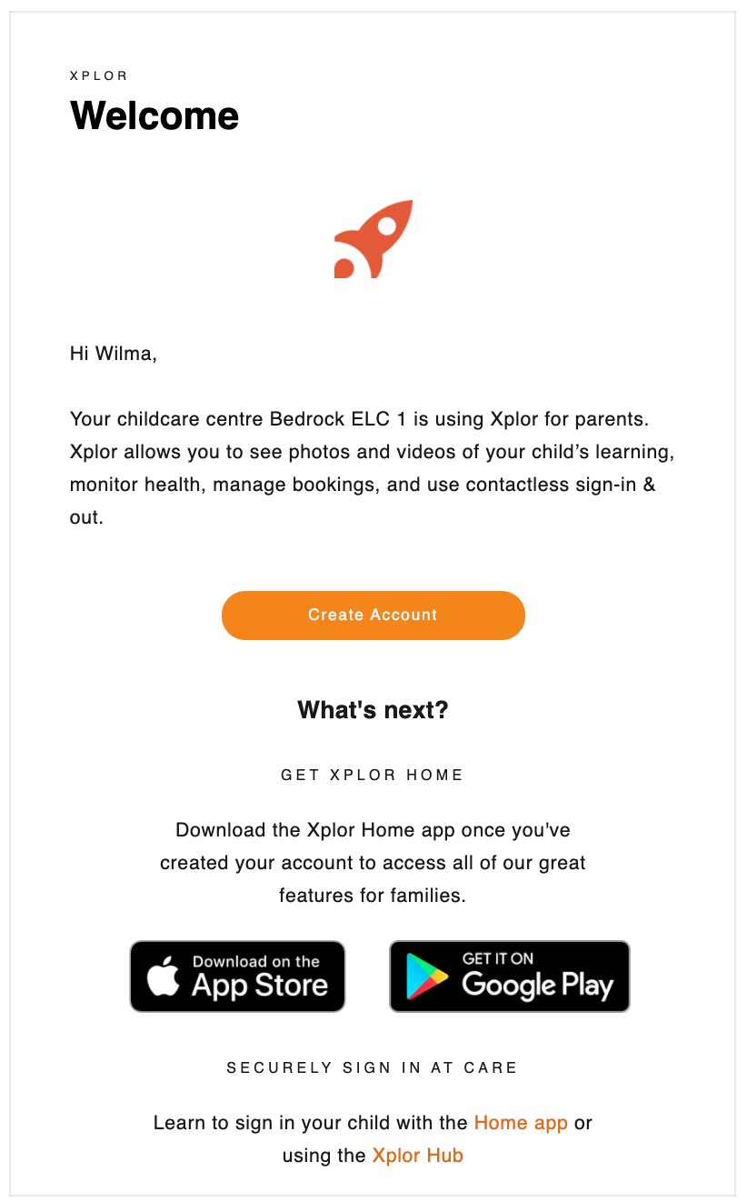
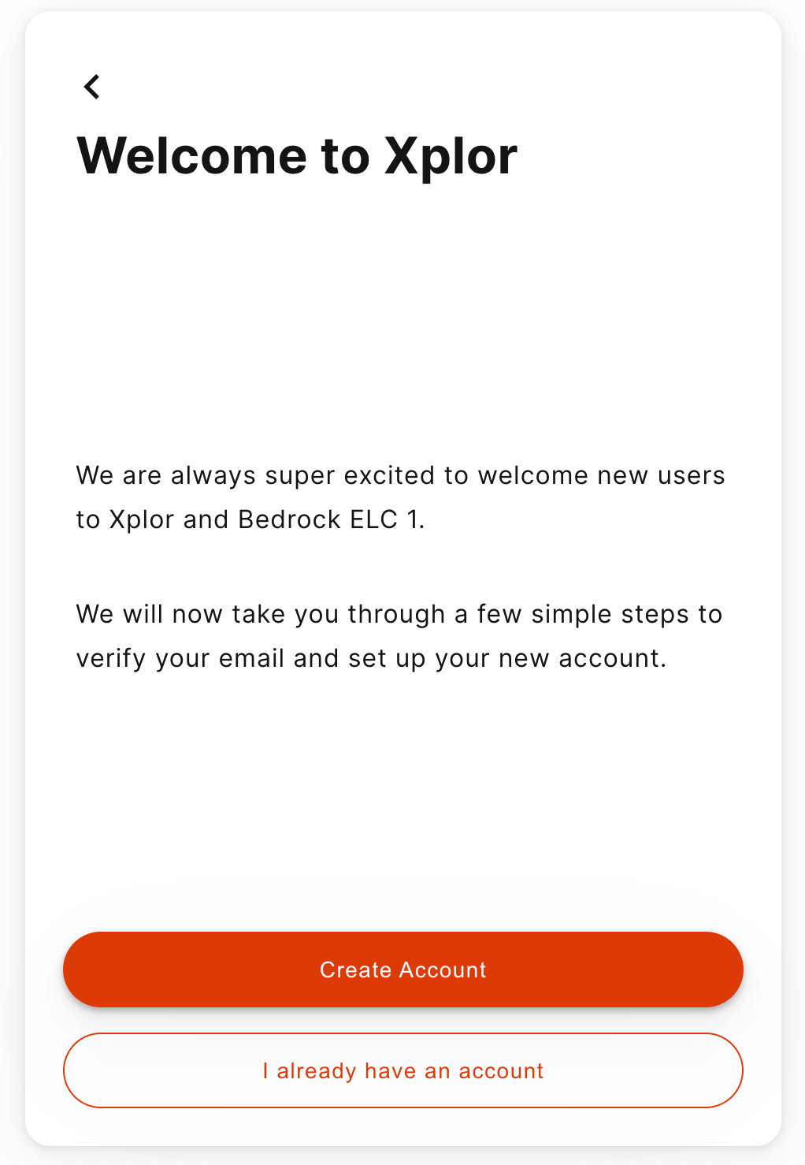
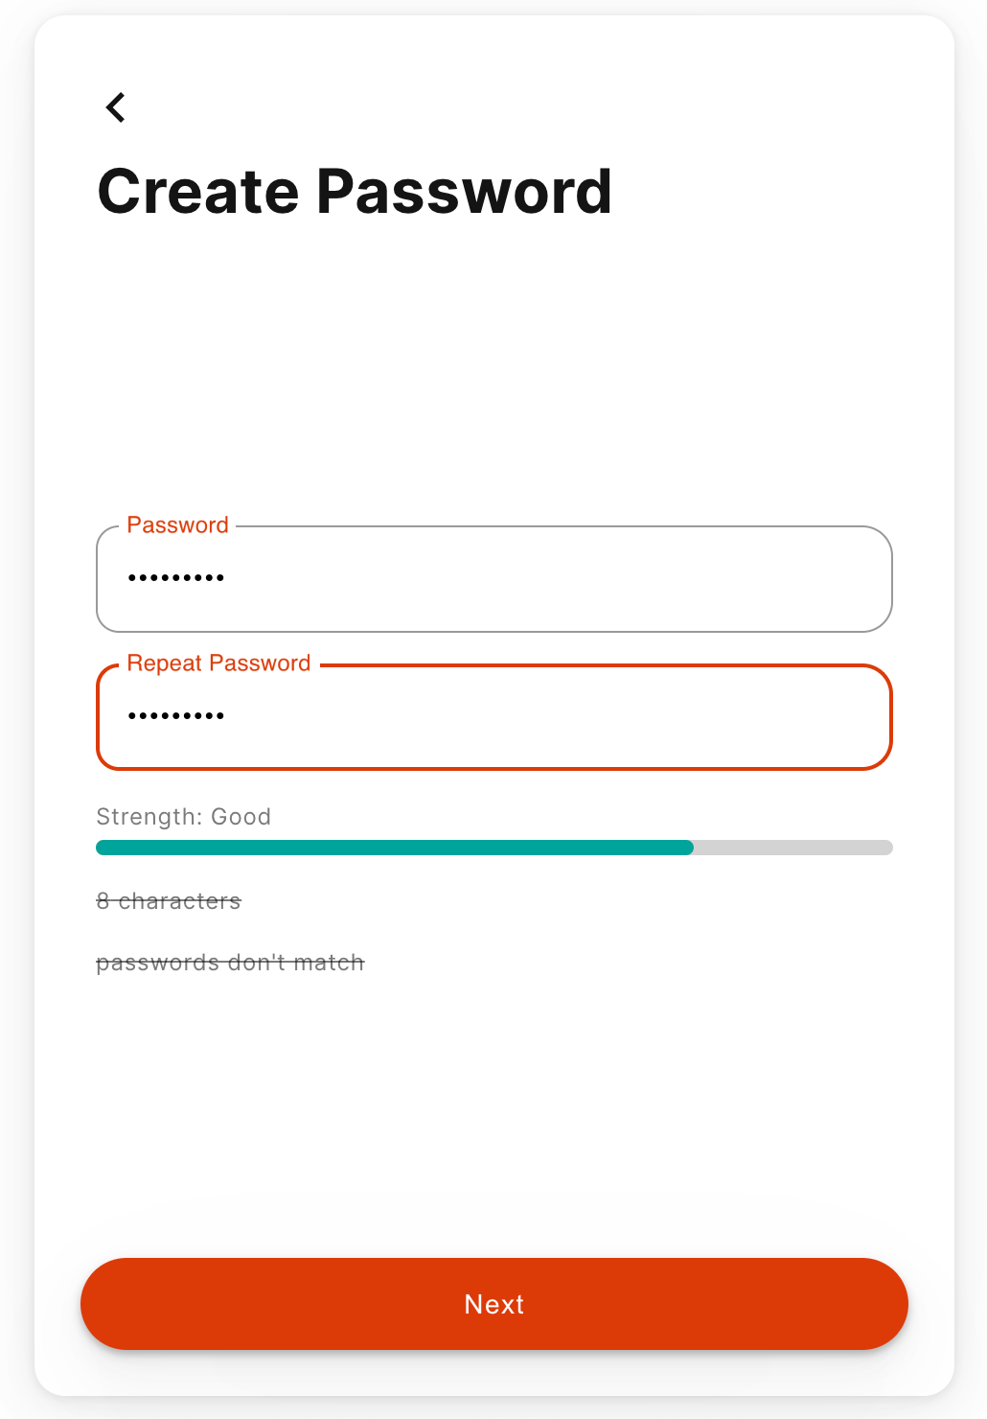
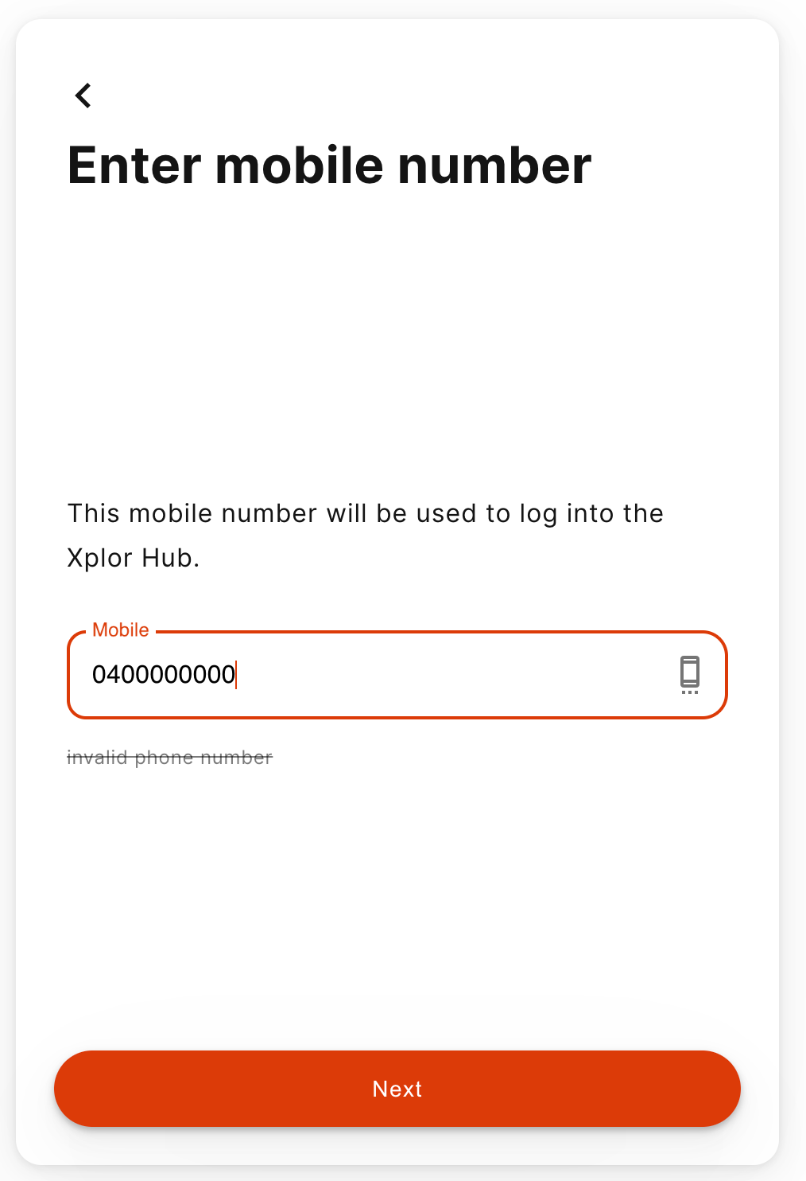
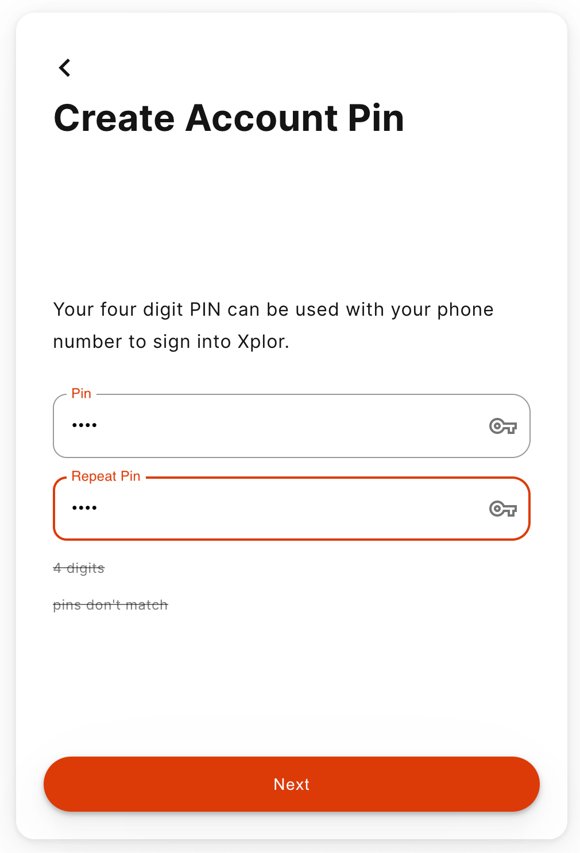
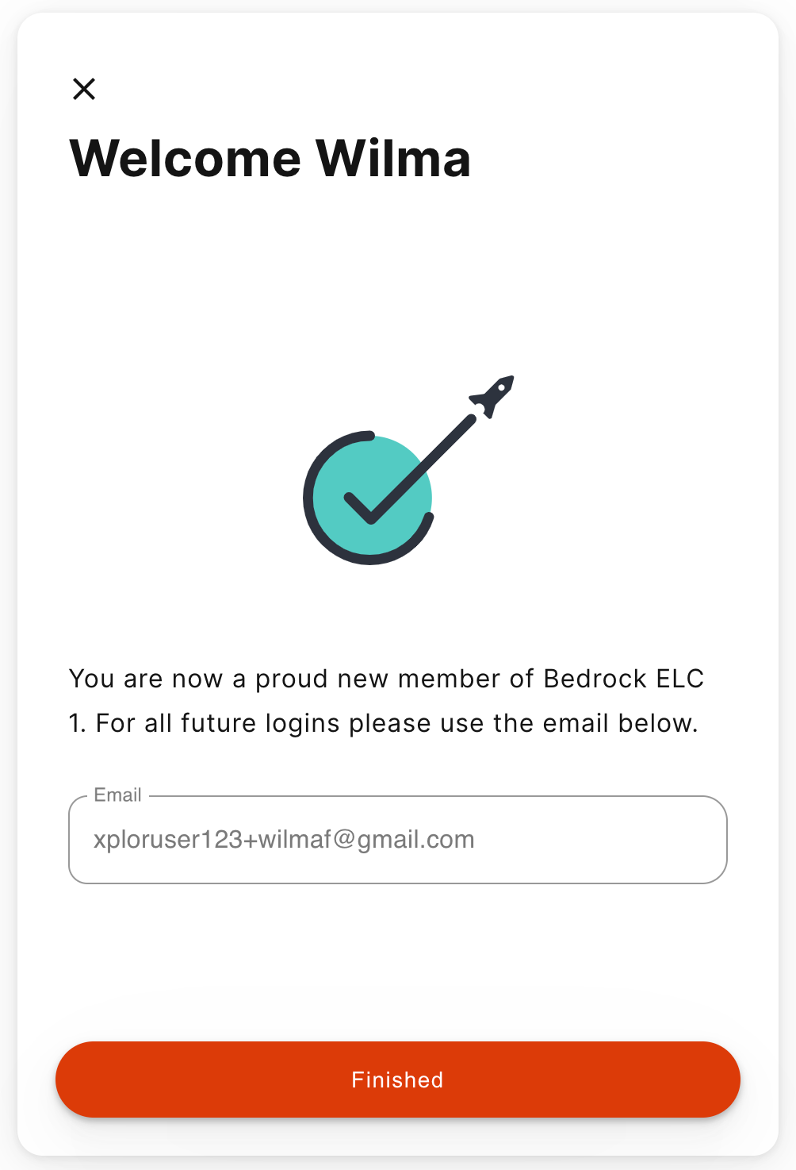
1
2
3
Setting up your Xplor Account for the first time
1
Check for an invitation email in your Inbox and select Create Account.
Click Create Account.
Tap Password.
Enter Mobile Number.
Enter Account Pin.
All Done!
2
3
4
5
6
4
5
6

Slide 3
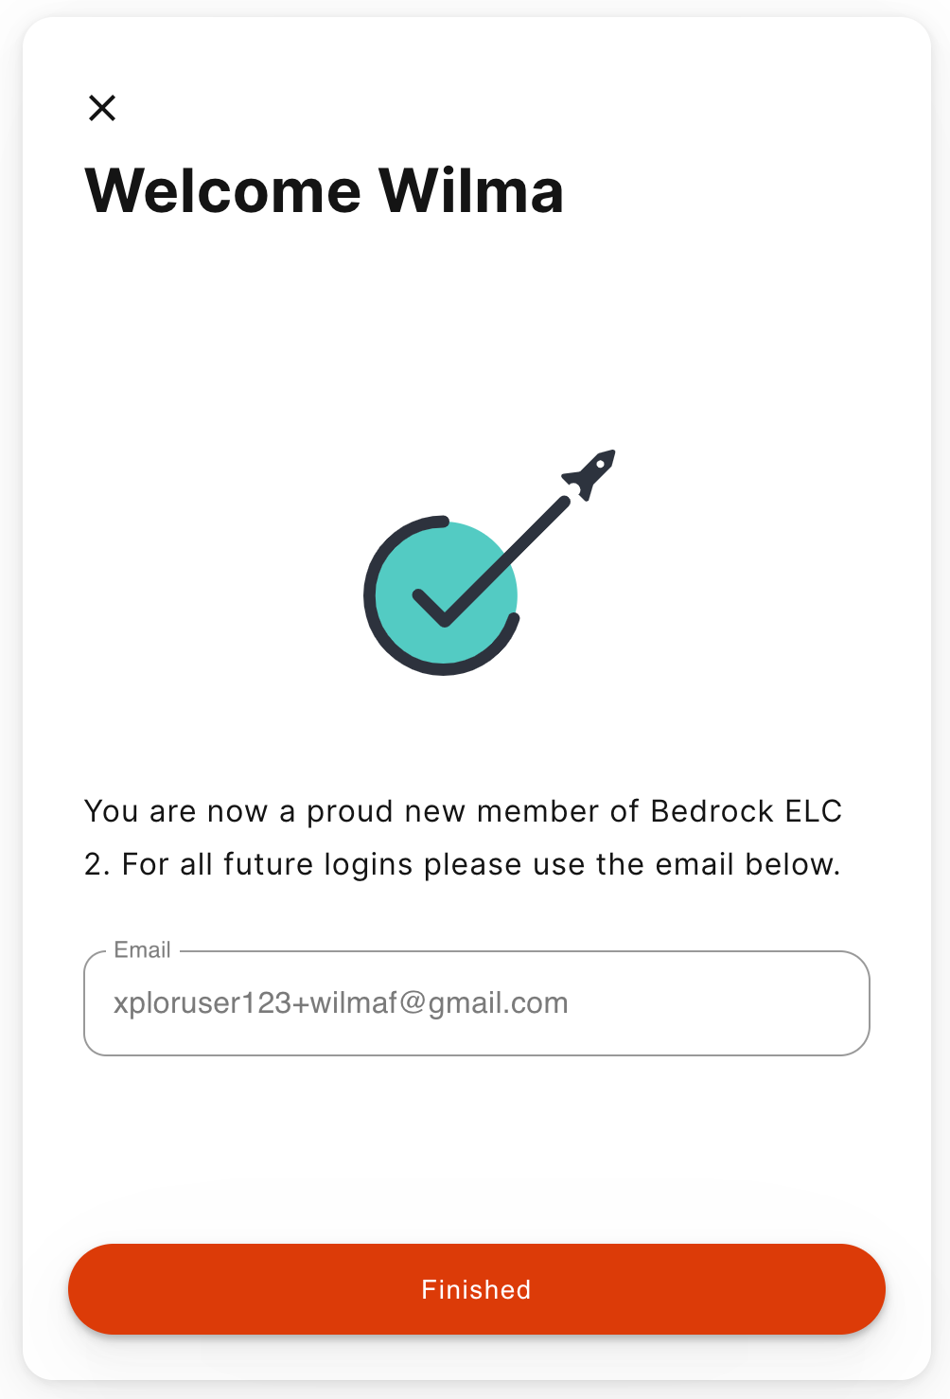
Already have an Xplor account?
1
2
1
Check for an invitation email in your Inbox and select Create Account.
All Done!
The system will automatically detect if your email address is currently registered with Xplor and will automatically merge your accounts together!
2

Slide 4
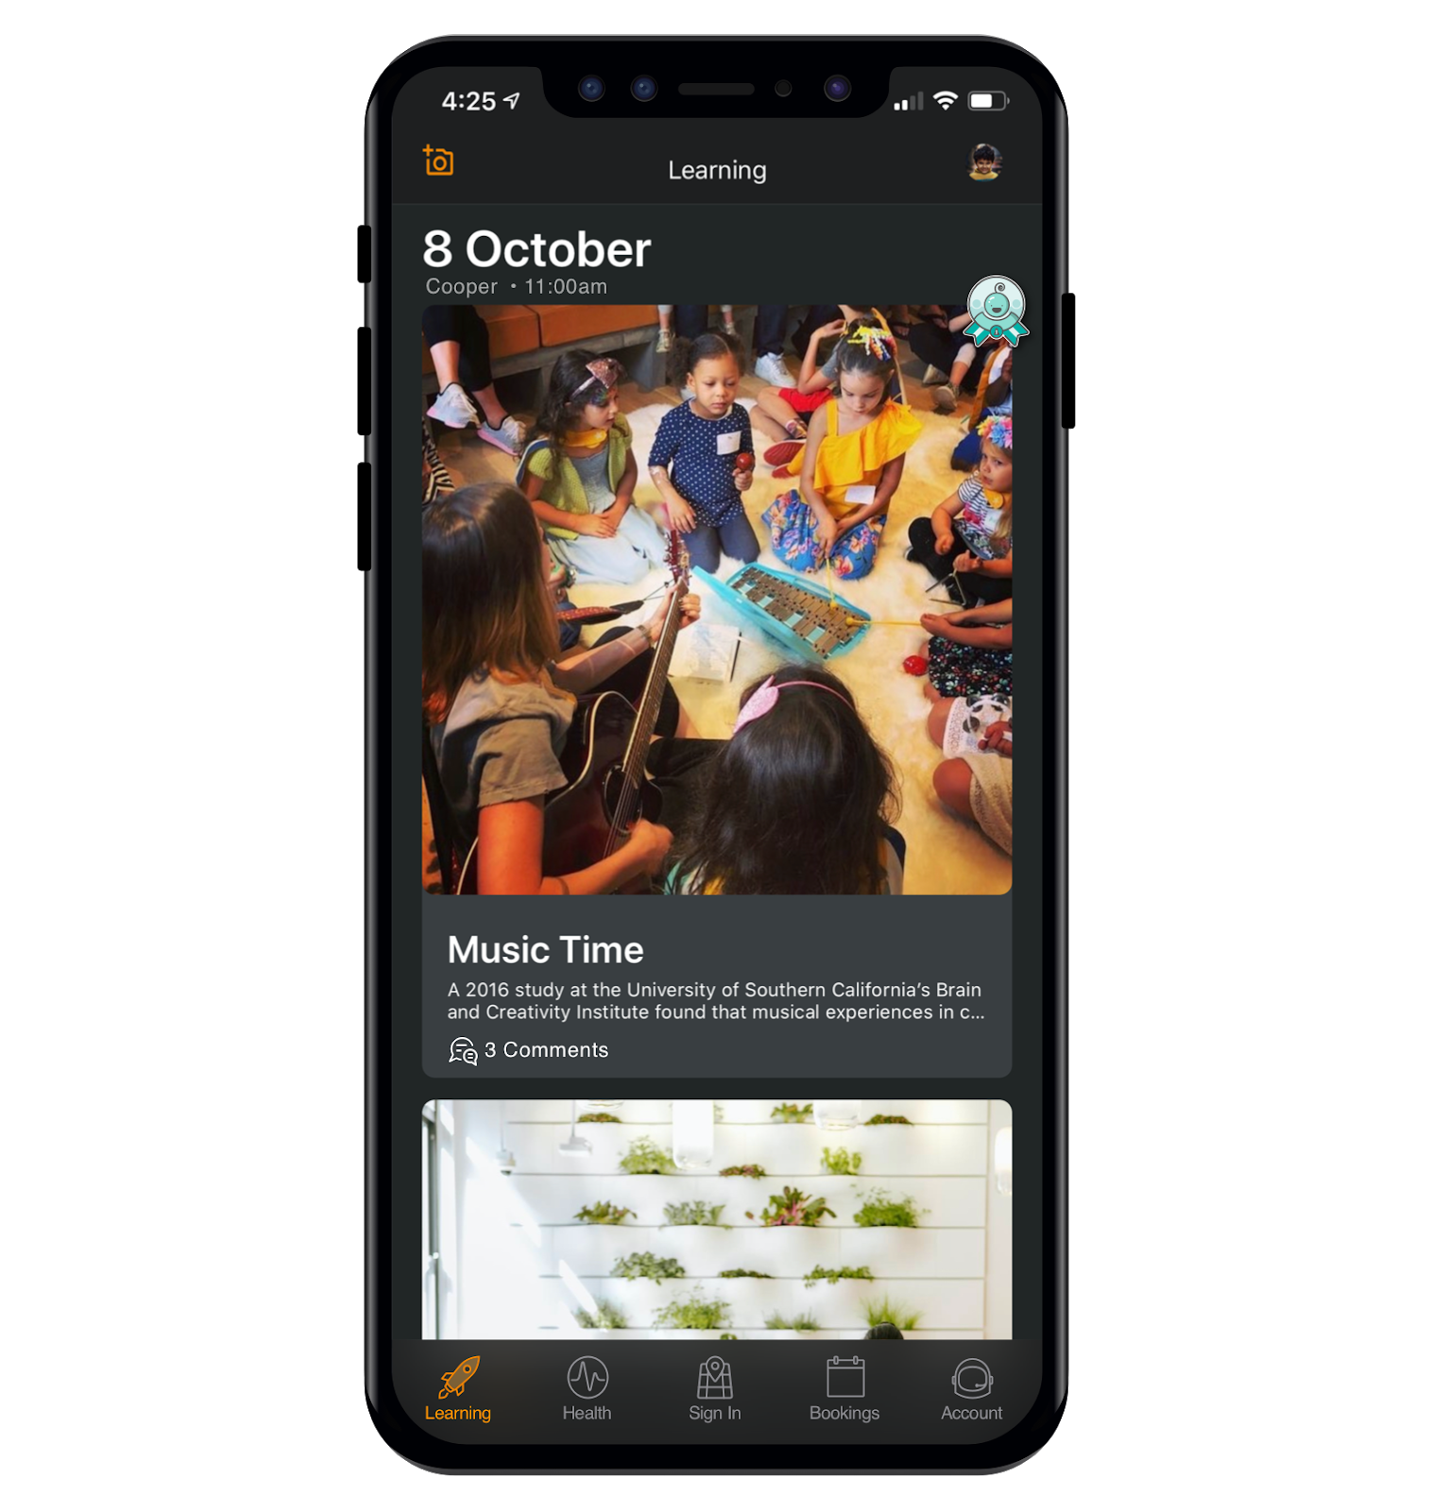
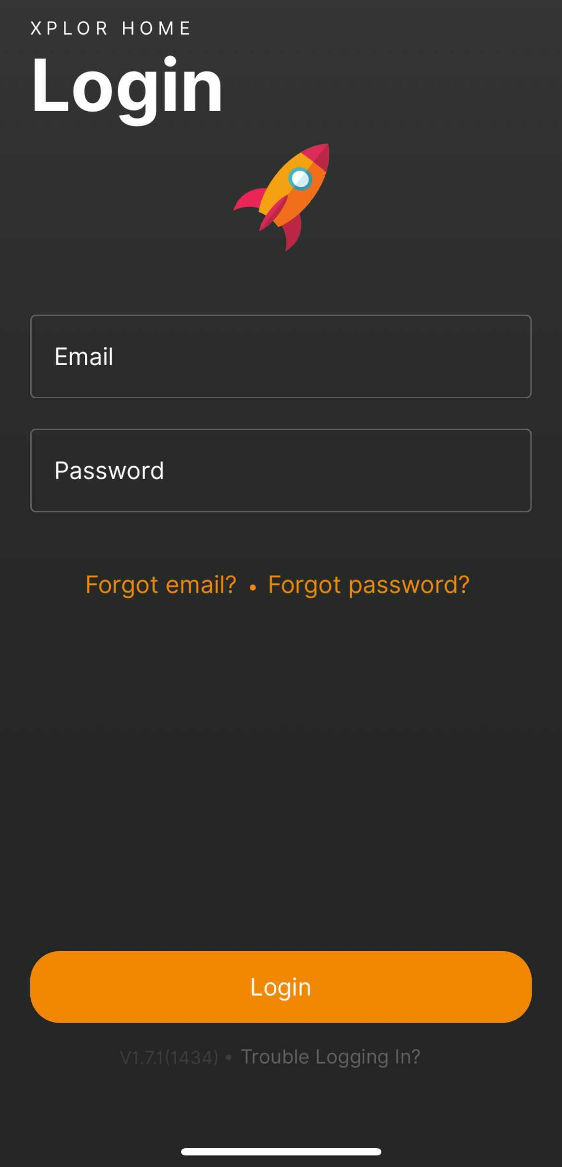
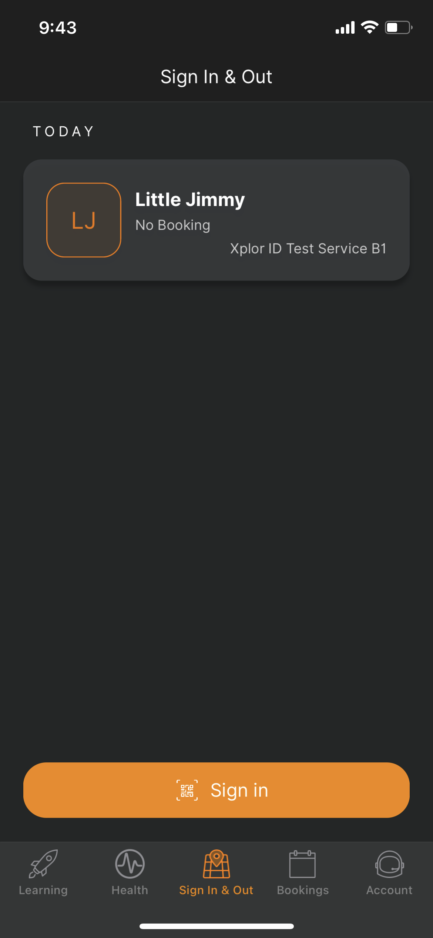
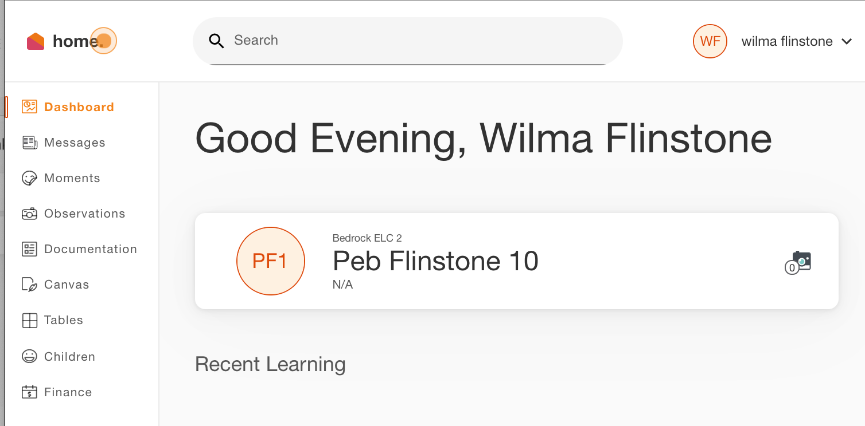
LOGGING IN
Now that you have set up your account with Xplor and your service, you are now ready to log in to either the Home App and Home Web!
1
Download the Home App via the Google Play Store or Apple Store.
Login using your Email & Password.
All Done!
You can also log in any time on the Parent Home Web platform by going to home.myxplor.com.
See here for Home App FAQs
2
3
4
5

Slide 5
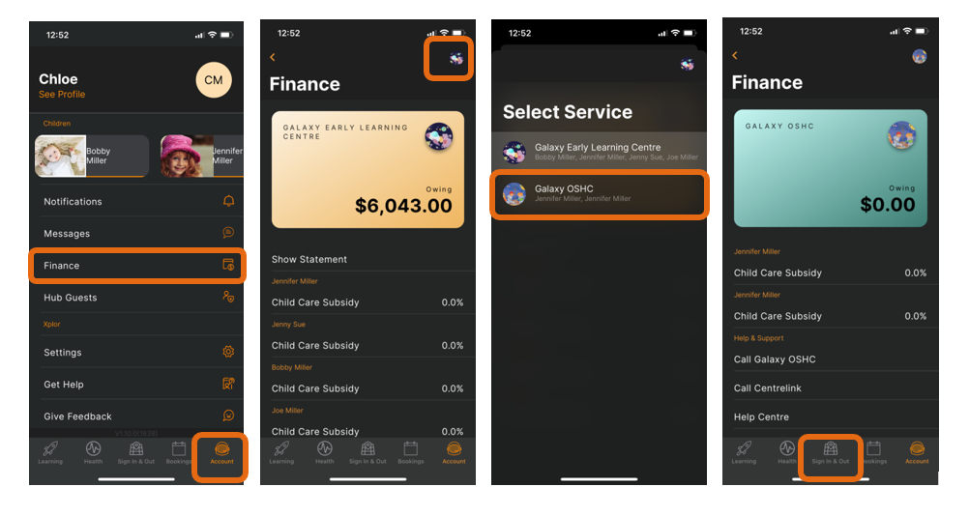
How to Toggle between centres through the Home App
1
Open the Xplor Home App
Tap on the Account Menu
Click on Finance
Click on the Centre logo
Select the new centre from the list
Click on Sign In & Out to return to the sign in/out screen
2
3
4
5
6

Slide 6
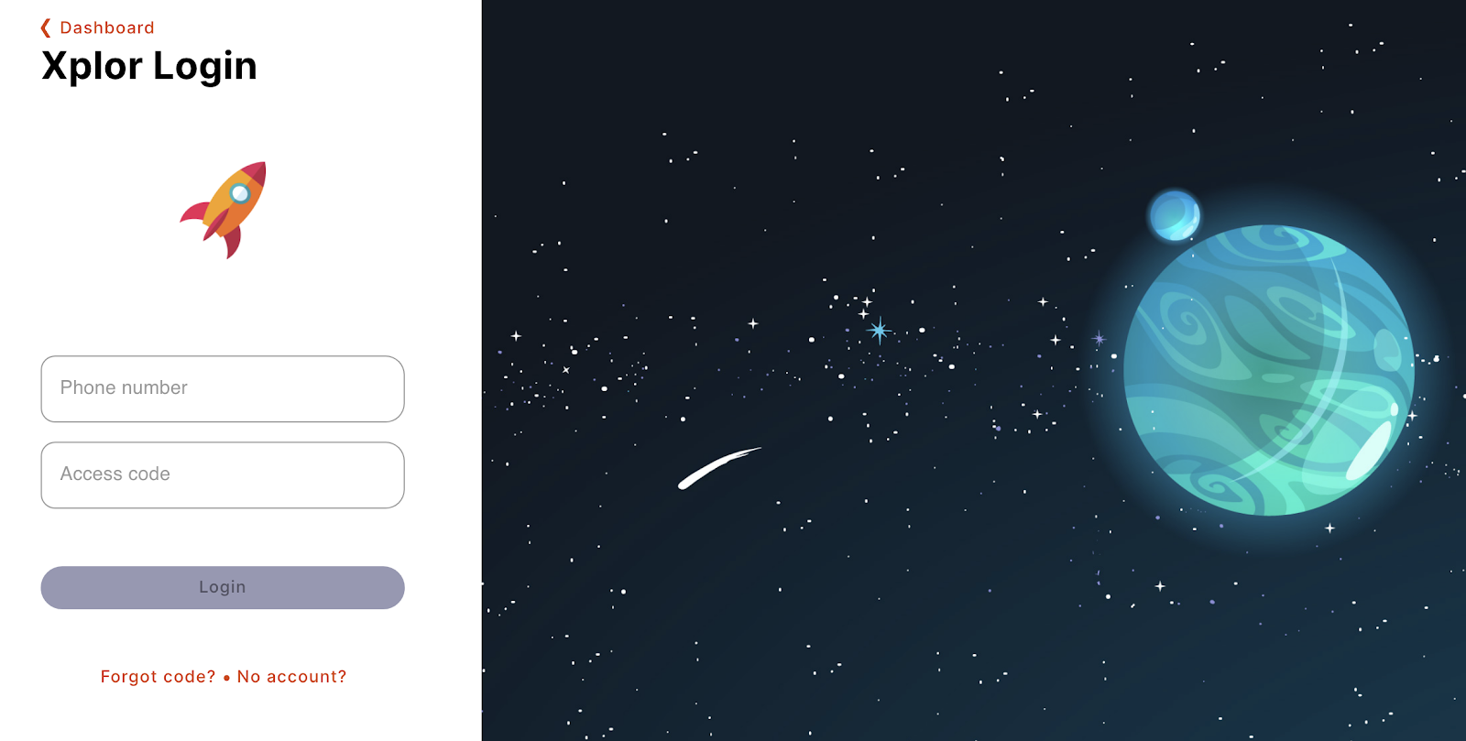
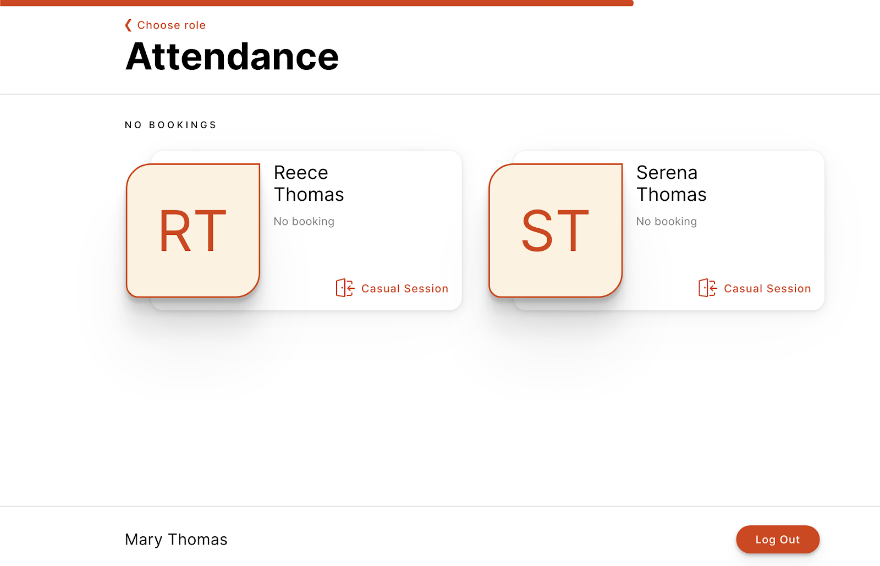
OPTION 2: Mobile Number and PIN
1
3
Tap Sign In
Enter Mobile Number and PIN
2
Tap your child’s name to sign in or out!

Slide 7
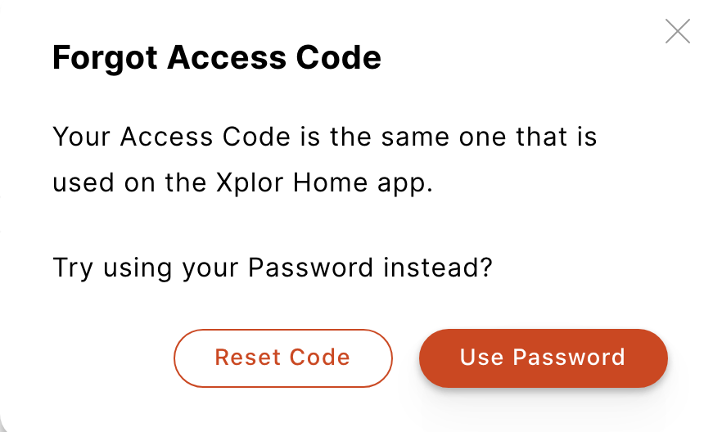
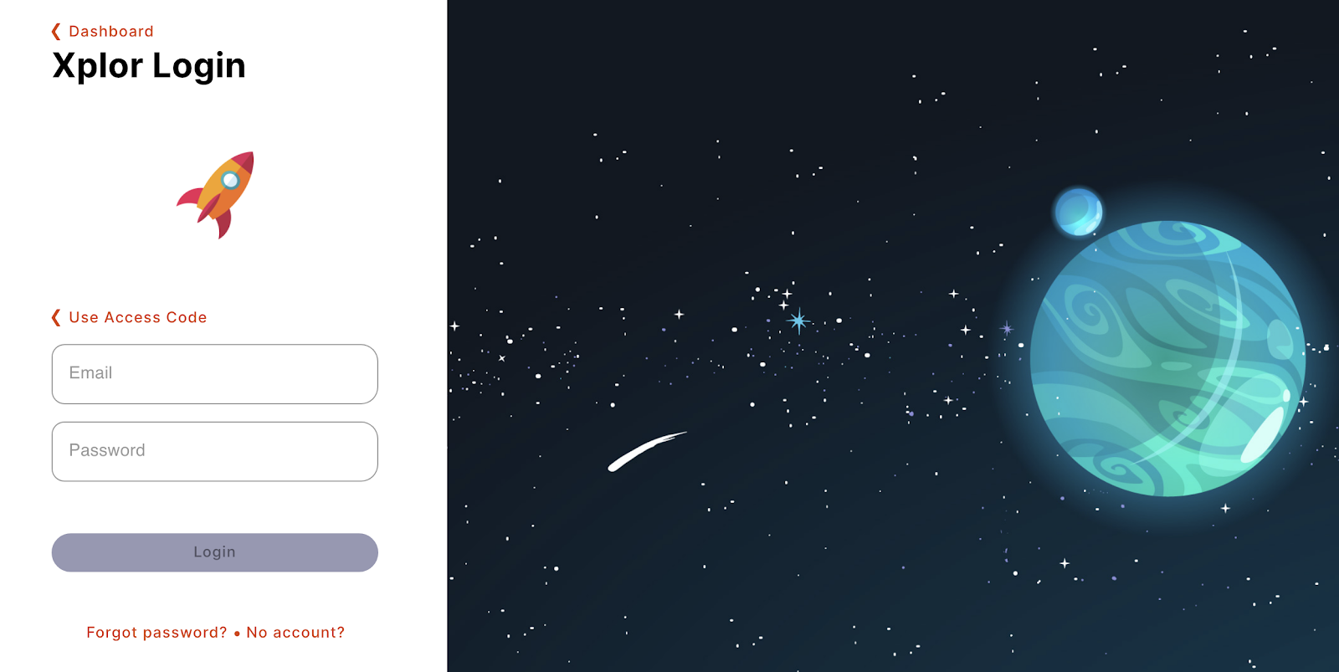
OPTION 3: Email and Password
1
Tap Sign In
2
Tap Forgot Code?
3
Tap Use Password
4
Enter Email and Password
4
Tap your child’s name to sign in or out!

Slide 8
XPLOR HOME
4
MANAGING CONTACTS
Invite family and/or friends to pick up and drop off your child

Slide 9
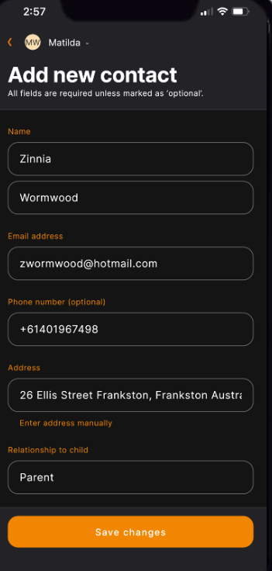
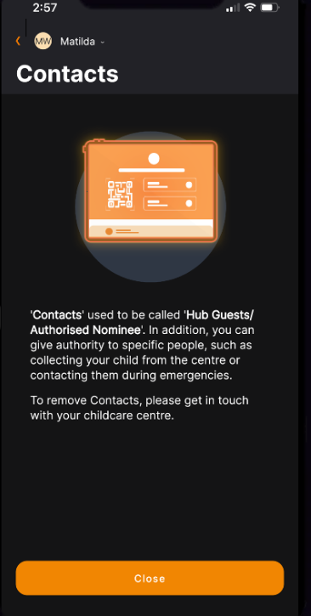
Invite family and/or friends to pick up and drop off your child
How to invite a Contact via the Home App for Collection
1. As the Primary Carer, log into your Xplor Home App
2. Navigate to Account
3. Select Contact
4. Select the Child you are wanting to add a contact to
5. Press the +ADD on the top right of the screen
6. Select either Add Existing Contact or Add New Contact
7. Fill out the Contact details.
8. Once completed, select Send Invite
Contact Account Creation Steps
1. Contact will receive a Welcome email to create password once you have sent an invite.
2. The Contact is to press 'Accept Invite' and follow the steps to create their account.
Contact sign in options
Contacts can sign your child in using the two options below.
Option 1: Use Mobile Number and PIN
Option 2: Email and password
Note: Contacts do not have access to the Home App.

Slide 10
XPLOR HOME
5
MANAGING YOUR CHILD’S BOOKINGS
View and manage your child’s future bookings using Xplor Home App

Slide 11
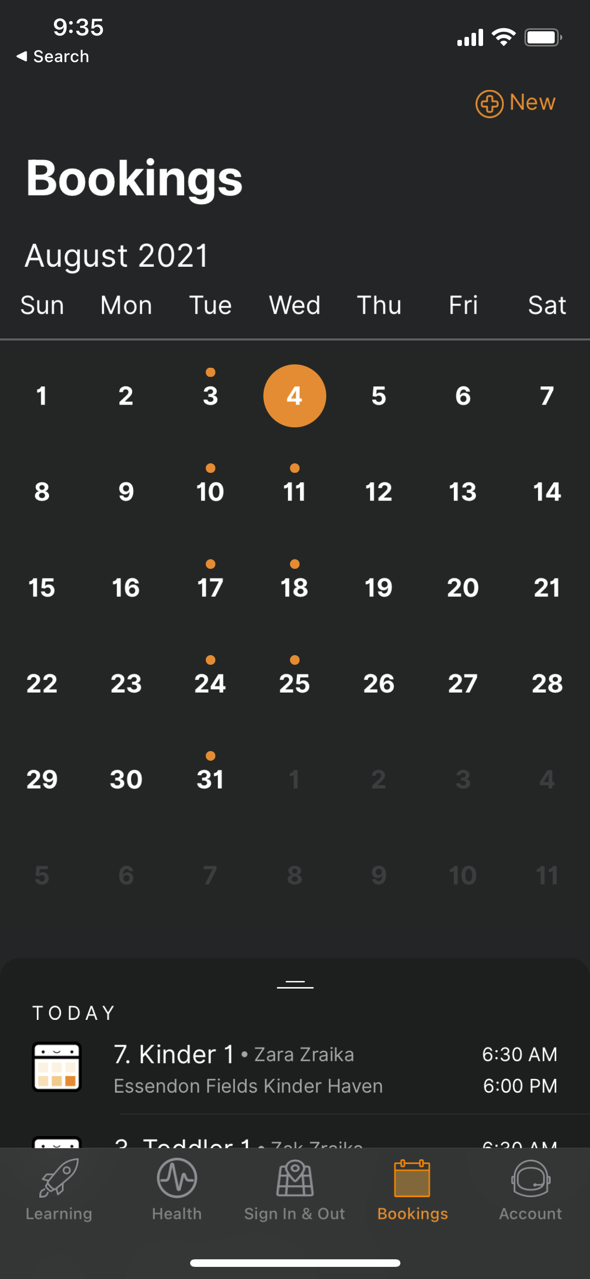
3
Managing your child’s bookings on the Home App
1
Select the Bookings option in your Home App.
Any future bookings will be indicated by an orange circle in the calendar. You can tap on those dates to view more details about the booking.
Tap the + New icon on the top right corner to request for additional bookings/absences.
You will receive a push notification once the service admin has rejected/accepted the booking request.
Note: You may not see future bookings until after your services Go Live date.
2
2
3
1

Slide 12
XPLOR HOME
6
USING PAY NOW
Please note: only the primary carer of the child will be able to see financial statements and make payments.

Slide 13
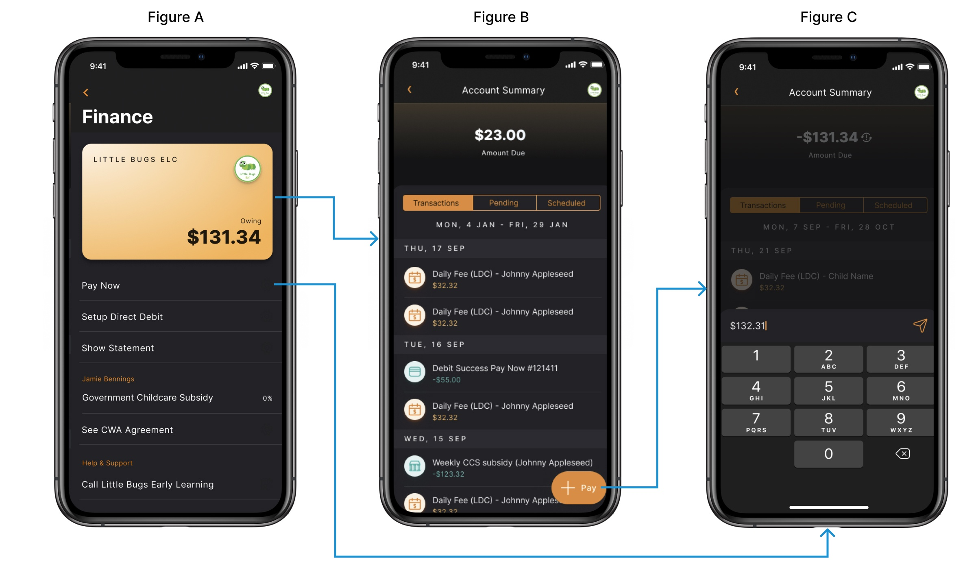
HOME APP
Making a payment via Home App
1
In the Home App, navigate to Settings > Finance.
2
Tap "Pay" in the bottom righthand corner
3
Choose an amount to pay.

Slide 14
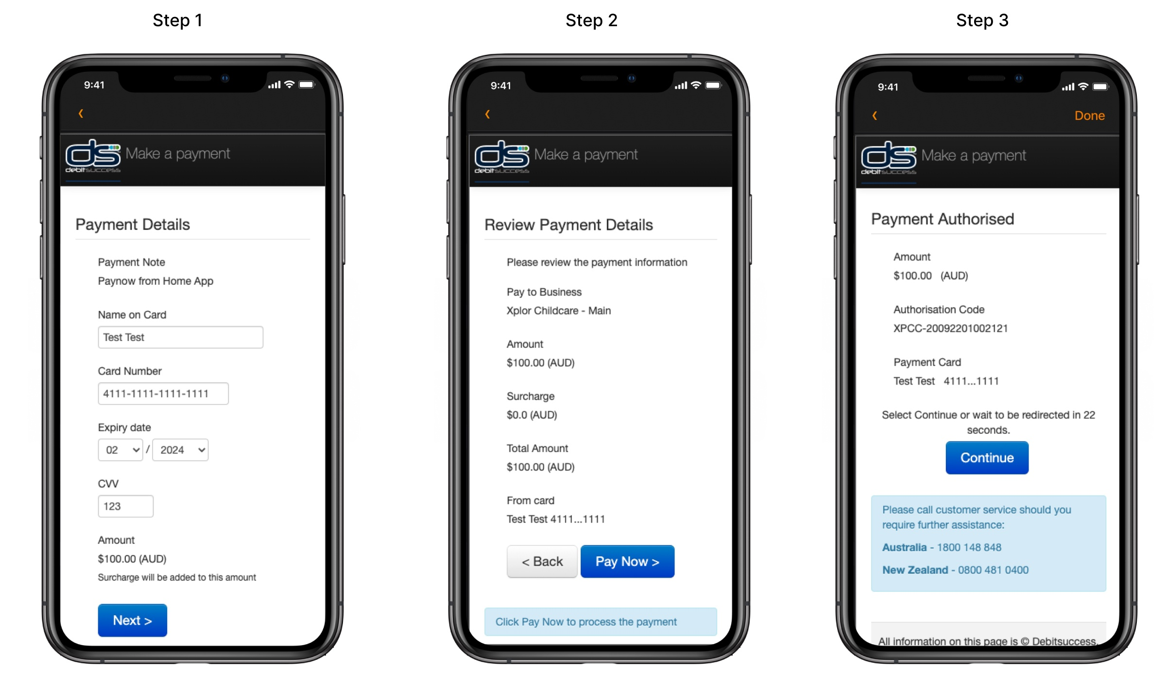
HOME APP
Making a payment via Home App continued...
4
Enter your card payment details into the secure form and confirm the amount is correct.
5
Review your payment details.
6
Submit your payment. All done!

Slide 15
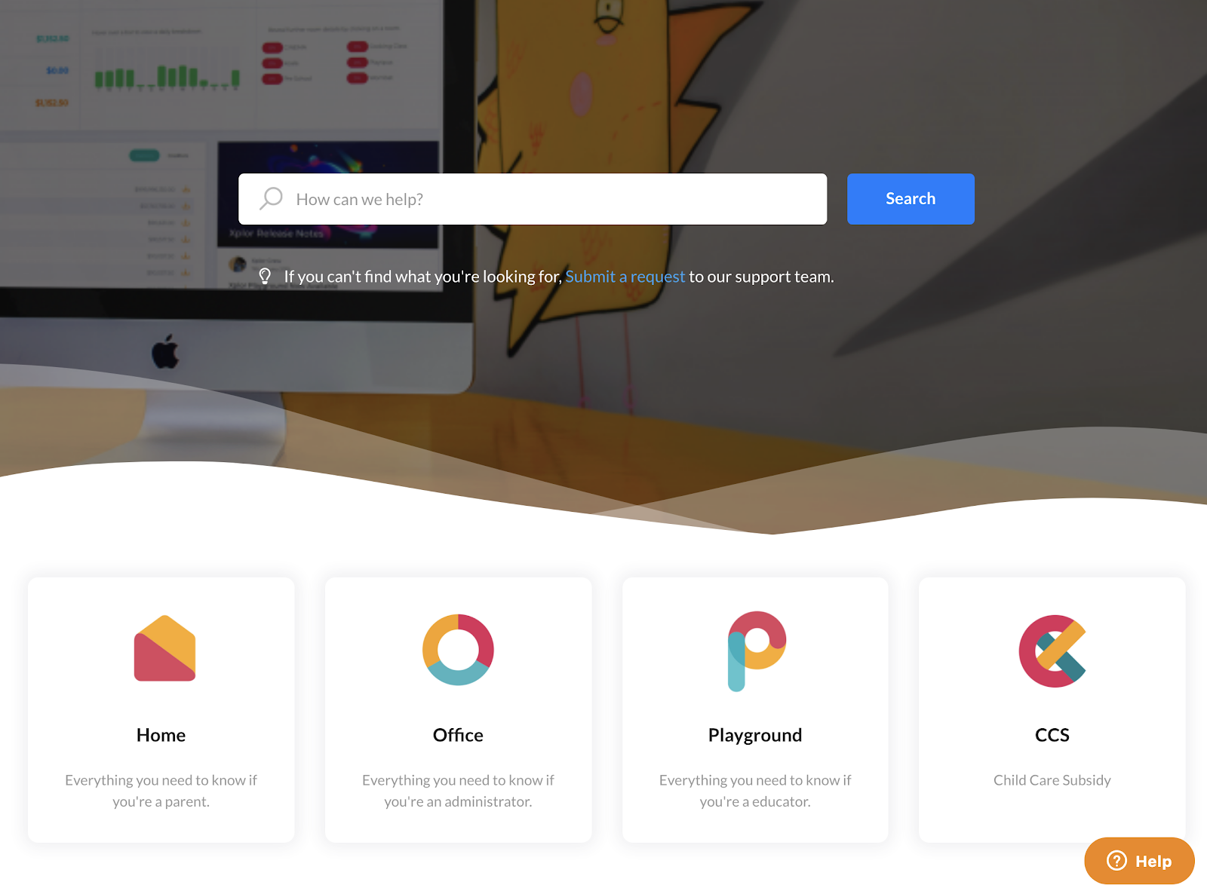
XPLOR SUPPORT
For more resources,
Visit our online knowledge base https://support.myxplor.com/s/

Slide 16
THANK YOU

